Slide 1

Topic : Exploratory Data Analysis with aimsir17

Slide 2
Course Overview
Topic | Description
Session 1
1 | Introduction to R and R Studio Cloud
2 | Exploratory Data Analysis: the tibble and ggplot2
3 | Functions, Vectors and Lists
4 | Introduction to Functionals with purrr
5 | Data Transformation I with dplyr
Session 2
6 | Data Transformation II with dplyr
7 | Statistical Transformation with ggplot2
8 | Functionals and Modelling with purrr
9 | Exploratory Data Analysis - Case Study using aimsir17

Slide 3
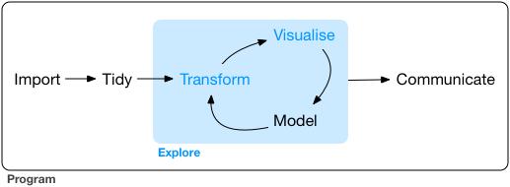
Exploratory Data Analysis
“Data exploration is the art of looking at your data, rapidly generating hypotheses, quickly testing them, then repeating again and again and again.” (Wickham and Grolemund 2017).

Slide 4
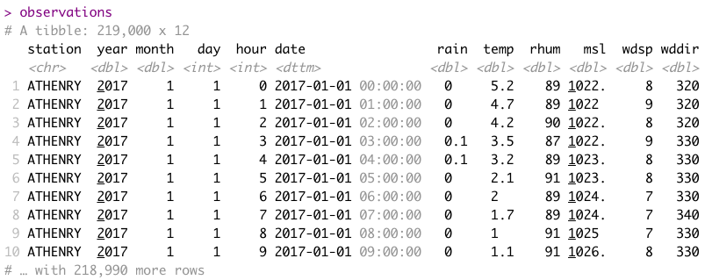
Data Set (1) - observations

Slide 5
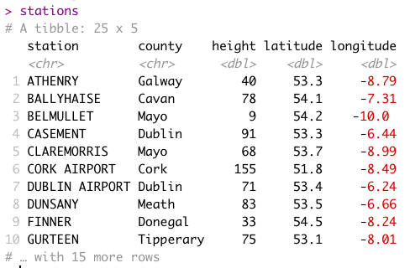
Data Set (2) - stations

Slide 6
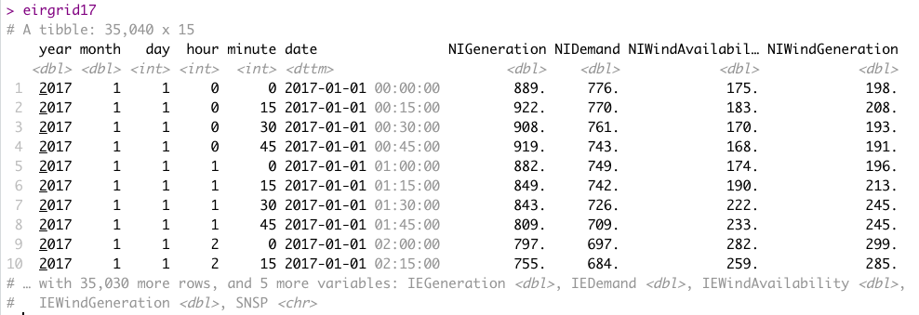
Data Set (3) – eirgrid17

Slide 7
Exploratory Data Analysis - Samples
Weather (Pick 3 stations)
West v East v South, is there a difference in annual rainfall, temperature?
Overall
What is the driest month of the year?
Association between atmospheric pressure and rainfall?
Energy
Association between average temperature and energy demand?
Which weather station’s average wind speed produces the best linear model for wind energy generated.

